Slide 1


MASTER-ACADEMY
Continuous Monitoring
With Nagios
Week 5
DevOps Boot Camp 2021

Slide 2
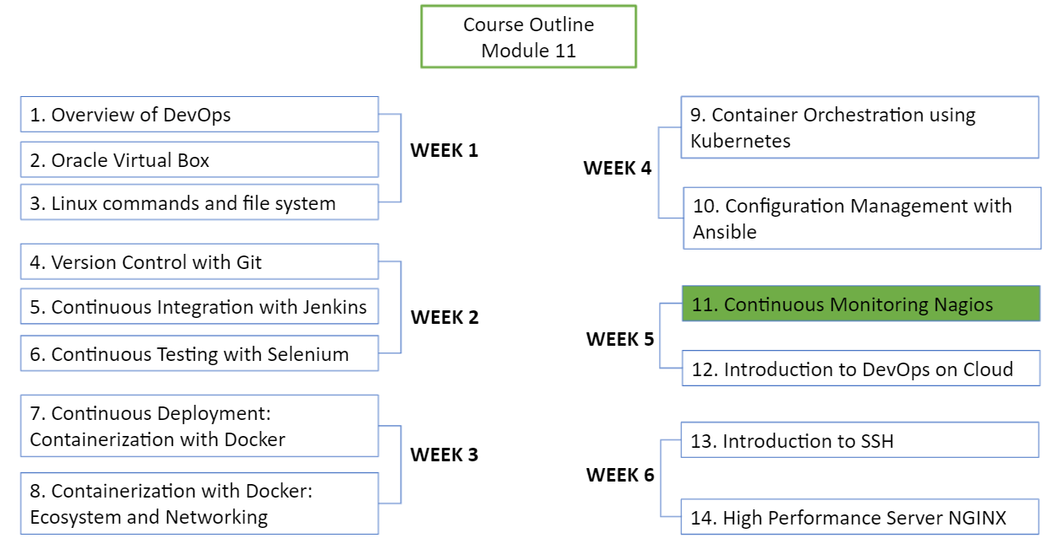
MASTER-ACADEMY
DevOps Boot Camp 2021

Slide 3
Topics
MASTER-ACADEMY
Continuous Monitoring
Introduction to Nagios
Nagios Architecture
Objects in Nagios
States in Nagios
Nagios Dashboard
DevOps Boot Camp 2021

Slide 4
Objective
MASTER-ACADEMY
At the end of this module you will be able to
Understand Continuous Monitoring
Introduction to Nagios
Install Nagios
Learn about the Nagios Plugins (NRPE) and Objects
Understand different types of states in Nagios
Execute different Nagios Commands and Notifications
Understand about Nagios Dashboard and how to monitor a remote host
DevOps Boot Camp 2021
Notes:
Use Annotation # 1

Slide 5

Why we use Monitoring?
MASTER-ACADEMY
System monitoring is crucial in an organization’s mission critical system
Monitoring alerts system admins about a problem in the system beforehand
It enables preventive measures before any issue affects the system
Monitoring is essential in ensuring system availability
Keeping track of the status of a system
For example: Server disk space, file system status, status changes in the services etc.
DevOps Boot Camp 2021
Notes:
Use Annotation # 2

Slide 6
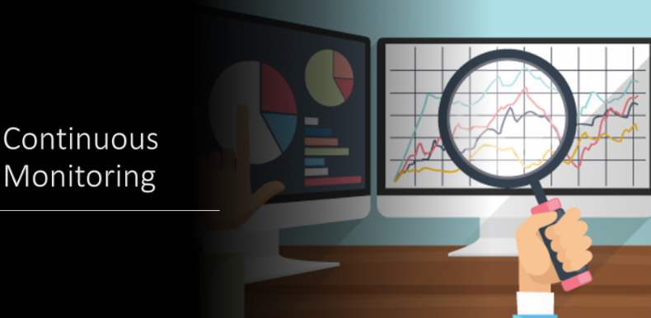
Benefits of Continuous Monitoring
MASTER-ACADEMY
It helps in getting rid of periodic testing
It detects split-second failures when the wrist strap is still in the “intermittent” stage
It reduces maintenance cost without sacrificing performance
It provides timely notification to the management of control and breakdown
DevOps Boot Camp 2021

Slide 7





Available Monitoring Tools in the Market
MASTER-ACADEMY
Real-time Monitoring
Log Monitoring
Container Monitoring
DevOps Boot Camp 2021

Slide 8



Why Nagios?
MASTER-ACADEMY
It can monitor database server such as SQL Server, Oracle, MySql, Postgres
It gives allocation level information (Apache, Postfix, LDAP, Citrix etc)
Active Development
Active Community
Nagios can work on multiple Operating Systems
It can ping to see if host is reachable
DevOps Boot Camp 2021
Notes:
Use Annotation # 3

Slide 9

What is Nagios?
MASTER-ACADEMY
It allows you to detect and repair problems and mitigate future issues before they affect end-user and customers
It is developed for monitoring servers, applications and network
It provides a centralized view of your entire IT infrastructure and detailed up-to-date status information
DevOps Boot Camp 2021

Slide 10
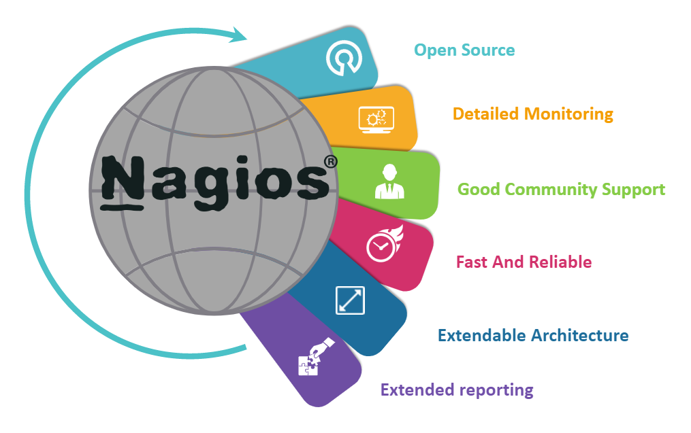
Features of Nagios
MASTER-ACADEMY
DevOps Boot Camp 2021

Slide 11
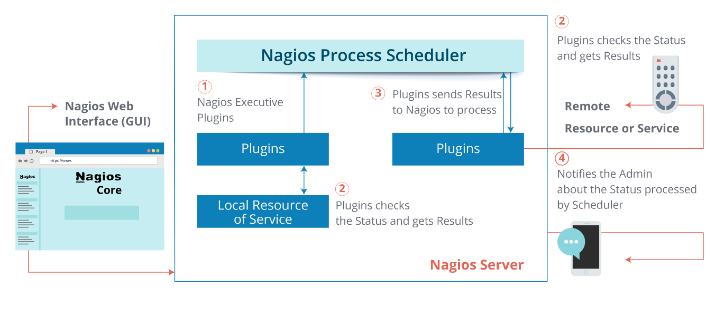
Nagios Architecture
MASTER-ACADEMY
DevOps Boot Camp 2021
Notes:
Use Annotation #4

Slide 12

Nagios Plugins
MASTER-ACADEMY
Plugins are compiled executables or scrips (Perl or non-Perl) that extends Nagios functionality to monitor servers and hosts
Nagios will execute Plugin to check the status of a service or host
Nagios can be compiled with support for an embedded Perl interpreter to execute Perl plugins
Without it, Nagios executes Perl and non-Perl plugins by forking and executing the plugins as an external command
Nagios comes with 50 plugins as default installation, these are binary files
Check plugins in directory: /usr/local/nagios/libexec
DevOps Boot Camp 2021

Slide 13
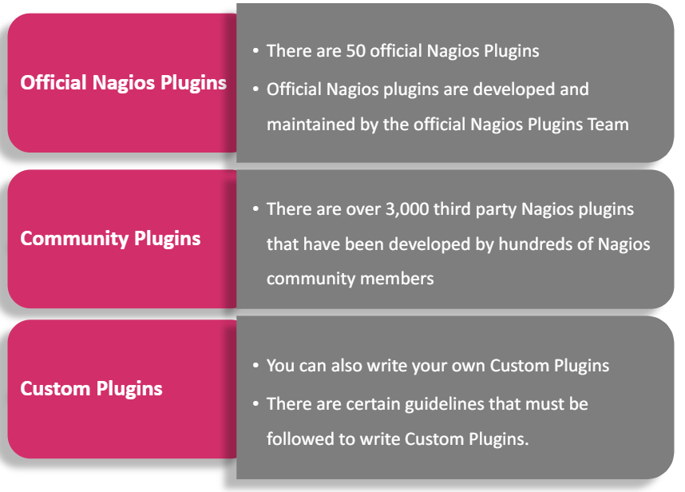
Types of Plugins
MASTER-ACADEMY
DevOps Boot Camp 2021

Slide 14
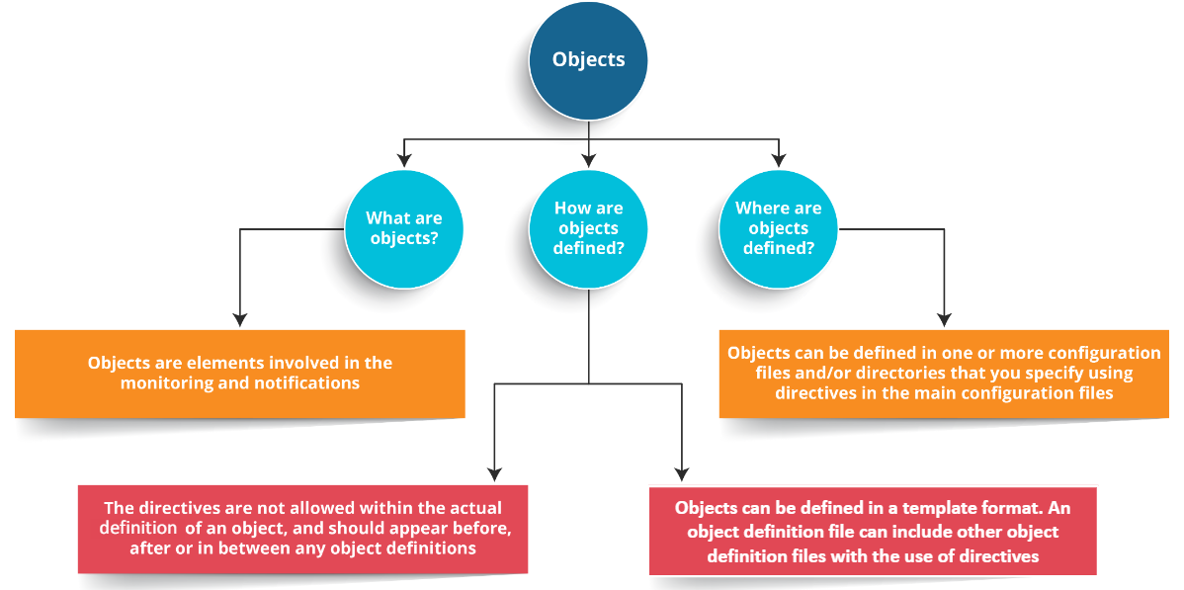
Nagios Objects
MASTER-ACADEMY
DevOps Boot Camp 2021

Slide 15
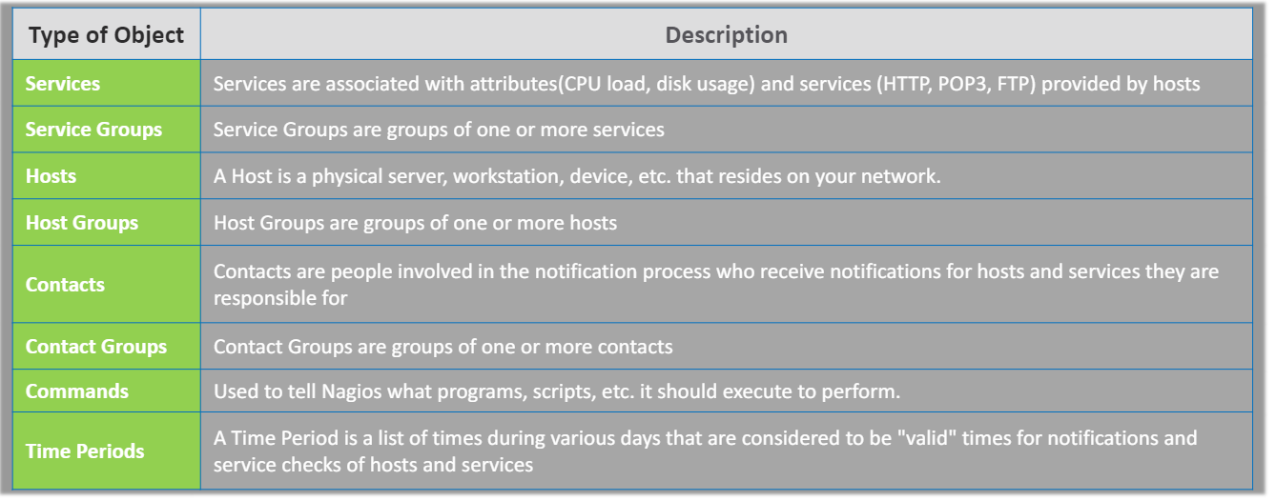
Object Types and Definitions
MASTER-ACADEMY
DevOps Boot Camp 2021

Slide 16
Nagios Installation
MASTER-ACADEMY
Need to spin up 2 EC2 VMs if using AWS or open 2 virtual box VMs
Nagios is not available as a binary package hence it require manual installation. Nagios needs to be installed from source. Here are the steps:
Change to root user: sudo -i
Download and Install Apache (All Nagios dependencies):
apt-get update && apt-get install build-essential apache2 php openssl perl make php-gd libgd-dev libapache2-mod-php libperl-dev libssl-dev daemon wget apache2-utils unzip
For VMbox use command: apt-get update && apt install -y autoconf bc gawk dc build-essential gcc libc6 make wget unzip apache2 php libapache2-mod-php libgd-dev libmcrcd ypt-dev make libssl-dev snmp libnet-snmp-perl gettext
Check if Apache is installed in Nagios Server by pasting public IP or static IP into the web browser
Create nagios user and nagcmd group and add the nagios and apache user to the part of the nagcmd group
useradd nagios
groupadd nagcmd
usermod -a -G nagcmd nagios
usermod -a -G nagcmd www-data
DevOps Boot Camp 2021

Slide 17
Nagios Installation (cont)
MASTER-ACADEMY
Install Nagios Core
cd /tmp
wget https://assets.nagios.com/downloads/nagioscore/releases/nagios-4.4.6.tar.gz
tar -zxvf /tmp/nagios-4.4.6.tar.gz
cd /tmp/nagios-4.4.6/
Perform the below steps to compile the Nagios from the source code
./configure --with-nagios-group=nagios --with-command-group=nagcmd --with-httpd_conf=/etc/apache2/sites-enabled/
make all
make install
make install-init
make install-config
make install-commandmode
Execute the below command in the terminal to install Nagios web interface
make install-webconf
Create Nagios Login and Password (use “nagios” as password)
htpasswd -c /usr/local/nagios/etc/htpasswd.users nagiosadmin
Run the following command: a2enmod cgi
Restart Apache Service to make the new settings take effect
systemctl restart apache2.service
DevOps Boot Camp 2021

Slide 18
Nagios Installation (cont)
MASTER-ACADEMY
In web browser type: <server public-ip/nagios>. Click Hosts and you will see an error. This is because Nagios plugins has not been installed yet. Install Nagios plugins:
cd /tmp
wget https://nagios-plugins.org/download/nagios-plugins-2.3.3.tar.gz
tar -zxvf /tmp/nagios-plugins-2.3.3.tar.gz
cd /tmp/nagios-plugins-2.3.3/
Compile and install the plugins
./configure --with-nagios-user=nagios --with-nagios-group=nagios
make
make install
Verify the sample Nagios configuration files. You should have “0” warnings and errors
/usr/local/nagios/bin/nagios -v /usr/local/nagios/etc/nagios.cfg
Enable Nagios to start automatically at system startup and start Nagios service
systemctl enable nagios
systemctl start nagios
Your localhost on Nagios dashboard should be up and services should come up
DevOps Boot Camp 2021

Slide 19
Nagios File System
MASTER-ACADEMY
nagios
/usr/local/nagios
bin
include
etc
libexec
sbin
share
var
/usr/local/nagios/etc
nagios.cfg
objects
resource.cfg
/usr/local/nagios/etc/objects
commands.cfg
contacts.cfg
localhost.cfg
templates.cfg
printers.cfg
switch.cfg
timeperiods.cfg
windows.cfg
DevOps Boot Camp 2021

Slide 20
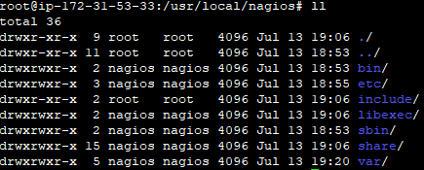
Nagios File System (cont)
MASTER-ACADEMY
Nagios is installed under directory /usr/local/nagios/
Under this directory libexec contain all the plugins as binary files. By default there are total 50 plus plugins installed
DevOps Boot Camp 2021

Slide 21
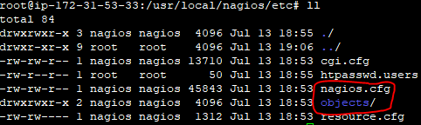
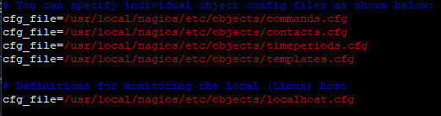
Nagios File System (cont)
MASTER-ACADEMY
The etc directory is the main operational directory and contain nagios.cfg file and objects directory /usr/local/nagios/etc/objects/
All the object resources in Nagios are defined inside the nagios.cfg file. This file determines what kind of resource/objects can be declared on the dashboard which can be external servers (linux/windows), log files, printers, routers, switches etc
DevOps Boot Camp 2021

Slide 22
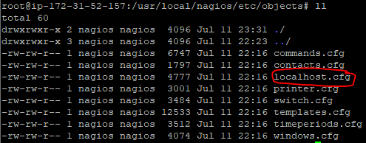
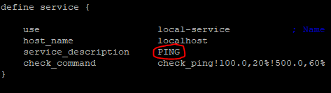
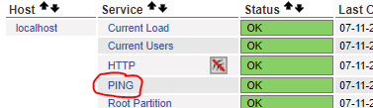
Nagios File System (cont)
MASTER-ACADEMY
Each element inside the Nagios dashboard is an object and stored inside the objects directory under the extension “.cfg”. These are the configuration files. All Nagios objects reside inside these cfg files
Go to directory: cd /usr/local/nagios/etc/objects and list all files
Open the localhost.cfg and you will see the services
DevOps Boot Camp 2021

Slide 23


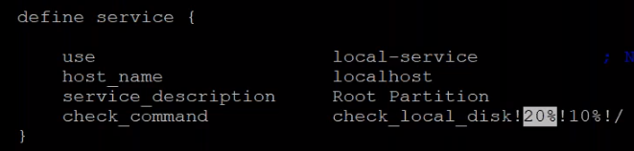
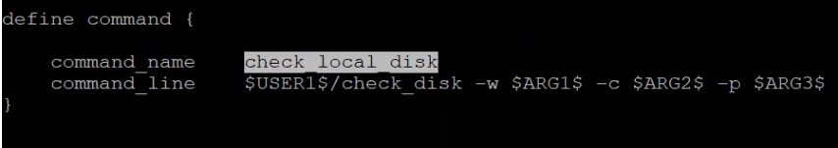
Service States
MASTER-ACADEMY
A host status can have 4 states
Up State
Down State
Unreachable State
Pending State
A service status can have 5 states
OK State
Warning State
Unknown State
Critical State
Pending State
We call plugins and designate values for the status check
DevOps Boot Camp 2021
Notes:
Annotation # 5 Required in this Slide

Slide 24
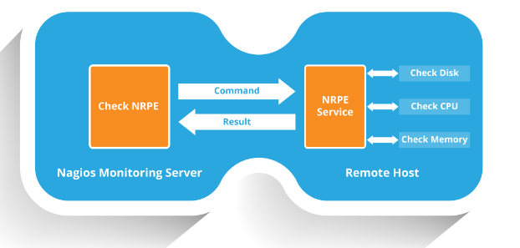
Nagios Remote Plugin Executor (NRPE)
MASTER-ACADEMY
NRPE allows you to remotely execute Nagios plugins on other Linux machines. This allows you to monitor remote machine metrics such as disk usage, CPU load etc.
It can communicate with some of the Windows agent addons, so you can execute scripts and check metrics on remote windows machine as well.
DevOps Boot Camp 2021

Slide 25

Monitoring a Remote Server
MASTER-ACADEMY
Connect to your remote machine (host) as root and install NRPE and Nagios plugins
sudo -i
apt-get update
apt-get install -y nagios-nrpe-server nagios-plugins
Modify the NRPE configuration file to accept the connection from the Nagios server, Edit the /etc/nagios/nrpe.cfg file
cd /etc/nagios/
vim nrpe.cfg
Add the Nagios servers IP address, separated by comma, then save and exit
Scroll down and add server public IP address
Add check_swap and check_root commands under the command lines, save and exit:
command[check_swap]=/usr/lib/nagios/plugins/check_swap -w 30% -c 10%
command[check_root]=/usr/lib/nagios/plugins/check_root -w 70% -c 80%
Test Nagios Check. The output will show PROCS OK
/usr/lib/nagios/plugins/check_procs -w 150 -c 200
Restart NRPE service: systemctl restart nagios-nrpe-server
DevOps Boot Camp 2021

Slide 26
Monitoring a Remote Server (cont)
MASTER-ACADEMY
Enable Firewall and IP table inside the server machine by running these commands. If you are using EC2 instance then first you need to define a custom TCP port 5666 in both EC2 machines, server and host :
apt install firewalld
firewall-cmd --permanent --add-port=5666/tcp
firewall-cmd --reload
iptables -I INPUT -p tcp --dport 5666 -m conntrack --ctstate NEW,ESTABLISHED -j ACCEPT
iptables -I OUTPUT -p tcp --sport 5666 -m conntrack --ctstate ESTABLISHED -j ACCEPT
Switch to Nagios server and install NRPE plugin
apt install -y nagios-nrpe-plugin
DevOps Boot Camp 2021

Slide 27

Monitoring a Remote Server (cont)
MASTER-ACADEMY
Edit configuration files in the Nagios server for it to enable monitoring
First edit nagios.cfg file: vim /usr/local/nagios/etc/nagios.cfg
Uncomment line cfg_dir=/usr/local/nagios/etc/servers
Create a new directory called server in etc: mkdir /usr/local/nagios/etc/servers
Now it’s time to configure the Nagios server to monitor the remote client machine, and You’ll need to create a command definition in Nagios object configuration file to use the check_nrpe plugin:
vim /usr/local/nagios/etc/objects/commands.cfg
Scroll to the bottom of the file and paste the following:
# .check_nrpe. command definition
define command{
command_name check_nrpe
command_line /usr/lib/nagios/plugins/check_nrpe -H $HOSTADDRESS$ -t 30 -c $ARG1$
}
DevOps Boot Camp 2021

Slide 28
Monitoring a Remote Server (cont)
MASTER-ACADEMY
Now need to add the Host server to the Nagios server. Create a client configuration file to define the host and service definitions of remote Linux host.
vim /usr/local/nagios/etc/servers/hostconfig.cfg
Step 1: copy and paste the content inside the file (copy from Google Doc)
Step 2: type ‘hostname’ to print hostname in host server
Step 3: copy the hostname and replace in the file for host, hostgroup and service
Step 4: in host definition replace IP address with public IP of host server
Step 5: after making changes save and exit
Verify Nagios for any error: The output will show PROCS OK
/usr/local/nagios/bin/nagios -v /usr/local/nagios/etc/nagios.cfg
To initiate change restart Nagios service: systemctl restart nagios
DevOps Boot Camp 2021

Slide 29
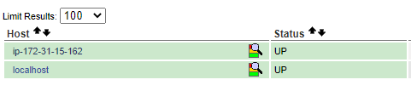
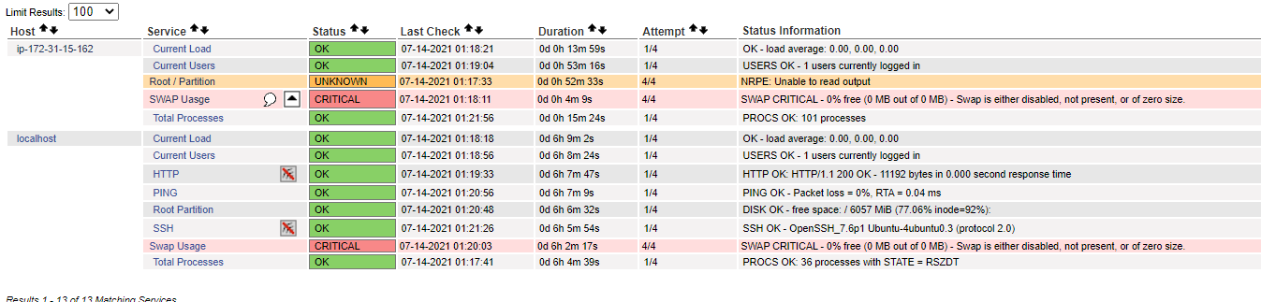
Check Result in Dashboard
MASTER-ACADEMY
Wait and check your Nagios dashboard and you should get a new host in your Host list. Wait for another minute for new host “ip-172-31-15-162” state to become OK
Check Services and you should see most of the services up and running
DevOps Boot Camp 2021

Slide 30
Thank You!

